Slide 1
JDBC Drivers

Slide 2
Java Database Connectivity (JDBC) is an application programming interface (API) for the programming language Java, which defines how a client may access any kind of tabular data, especially relational database. It is part of Java Standard Edition platform, from Oracle Corporation. It acts as a middle layer interface between java applications and database.
The JDBC classes are contained in the Java Package java.sql and javax.sql. JDBC helps you to write Java applications that manage these three programming activities:
Connect to a data source, like a database.
Send queries and update statements to the database
Retrieve and process the results received from the database in answer to your query

Slide 4
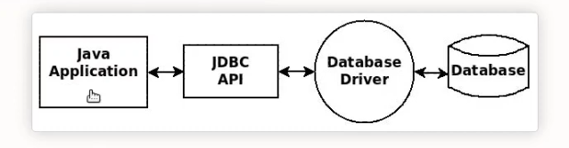
JDBC drivers are client-side adapters (installed on the client machine, not on the server) that convert requests from Java programs to a protocol that the DBMS can understand. There are 4 types of JDBC drivers:
Type-1 driver or JDBC-ODBC bridge driver
Type-2 driver or Native-API driver
Type-3 driver or Network Protocol driver
Type-4 driver or Thin driver

Slide 5
Type-1 driver
Type-1 driver or JDBC-ODBC bridge driver uses ODBC driver to connect to the database. The JDBC-ODBC bridge driver converts JDBC method calls into the ODBC function calls. Type-1 driver is also called Universal driver because it can be used to connect to any of the databases.
As a common driver is used in order to interact with different databases, the data transferred through this driver is not so secured.
The ODBC bridge driver is needed to be installed in individual client machines.
Type-1 driver isn’t written in java, that’s why it isn’t a portable driver.
This driver software is built-in with JDK so no need to install separately.
It is a database independent driver.

Slide 6
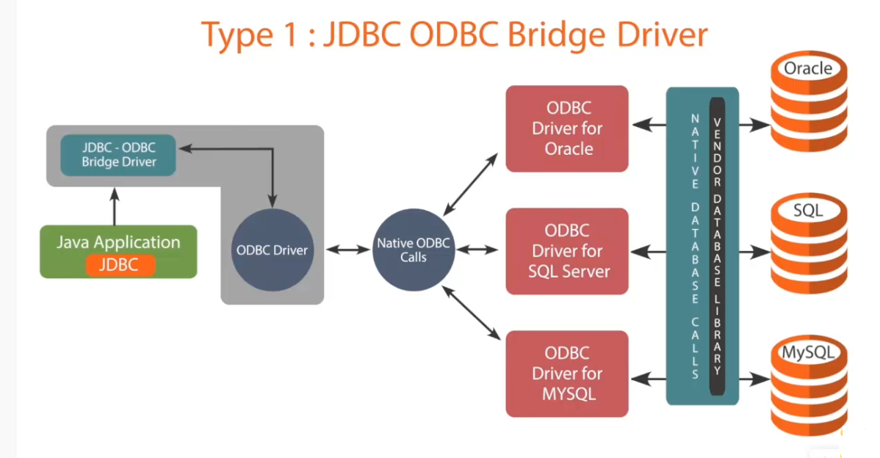

Slide 7
Type-2 driver
The Native API driver uses the client -side libraries of the database. This driver converts JDBC method calls into native calls of the database API. In order to interact with different database, this driver needs their local API, that’s why data transfer is much more secure as compared to type-1 driver.
Driver needs to be installed separately in individual client machines
The Vendor client library needs to be installed on client machine.
Type-2 driver isn’t written in java, that’s why it isn’t a portable driver
It is a database dependent driver.

Slide 8
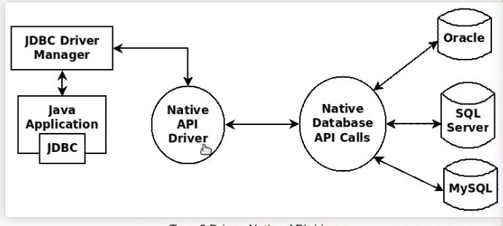

Slide 9
Type-3 driver
The Network Protocol driver uses middleware (application server) that converts JDBC calls directly or indirectly into the vendor-specific database protocol. Here all the database connectivity drivers are present in a single server, hence no need of individual client-side installation.
Type-3 drivers are fully written in Java, hence they are portable drivers.
No client side library is required because of application server that can perform many tasks like auditing, load balancing, logging etc.
Network support is required on client machine.
Maintenance of Network Protocol driver becomes costly because it requires database-specific coding to be done in the middle tier.
Switch facility to switch over from one database to another database.

Slide 10
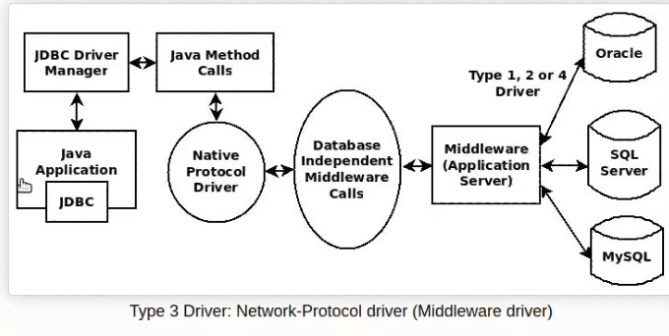

Slide 11
Type-4 driver
Type-4 driver is also called native protocol driver. This driver interact directly with database. It does not require any native database library, that is why it is also known as Thin Driver.
Does not require any native library and Middleware server, so no client-side or server-side installation.
It is fully written in Java language, hence they are portable drivers.

Slide 12
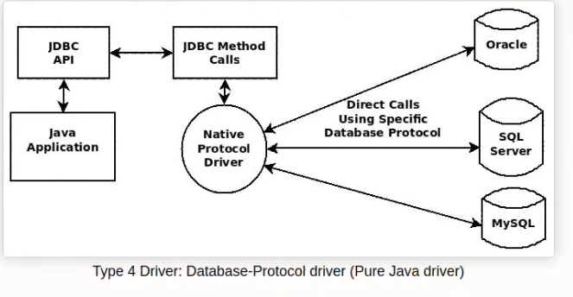

Slide 13
The current version of JDBC is 4.3. It is the stable release since 21st September, 2017. It is based on the X/Open SQL Call Level Interface. The java.sql package contains classes and interfaces for JDBC API. A list of popular interfaces of JDBC API are given below:
Driver interface
Connection interface
Statement interface
PreparedStatement interface
CallableStatement interface
ResultSet interface
ResultSetMetaData interface
DatabaseMetaData interface
RowSet interface
A list of popular classes of JDBC API are given below:
DriverManager class
Blob class
Clob class
Types class

Slide 14
Why Should We Use JDBC
Before JDBC, ODBC API was the database API to connect and execute the query with the database. But, ODBC API uses ODBC driver which is written in C language (i.e. platform dependent and unsecured). That is why Java has defined its own API (JDBC API) that uses JDBC drivers (written in Java language).
We can use JDBC API to handle database using Java program and can perform the following activities:
Connect to the database
Execute queries and update statements to the database
Retrieve the result received from the database.

